Slide 1
CAPSTONE III.
GLOBAL COST OF LIVING CLUSTERING.
Created by Elena Blake Nov, 2024

Slide 2
Content
Project Purpose
Dataset Exploration and Visualization
PCA Dimensionality Reduction
Clusters Visualization
Contingency Table
Takeaways and Further Considerations

Slide 3
Project Purpose
People across the world incur various expenses during their lifetime: food, shelter, education, entertainment, etc. Cost of living varies depending on geographic location and can be more or less affordable. For my project I’ve picked the dataset which contains information about the cost of living in almost 5000 cities across the world. The data were gathered initially by scraping Numbeo's website (https://www.numbeo.com). The dataset is located at Global Cost of Living (kaggle.com).
The purpose of this project is to analyze global living costs, to identify different clusters within the dataset and to evaluate clusters based on metrics.

Slide 4
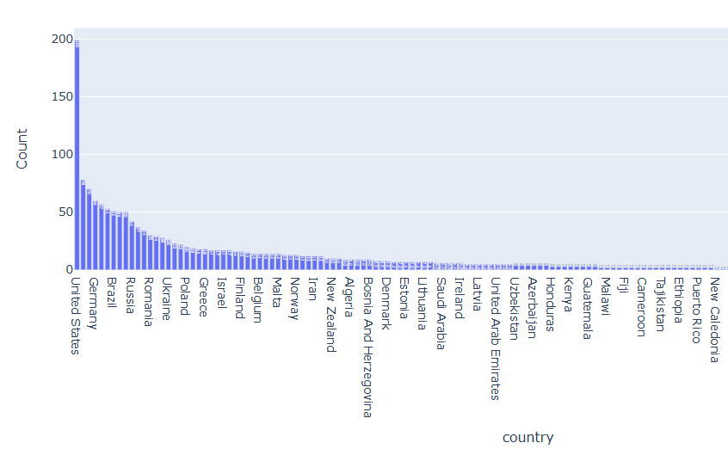
Data Exploration
Data contains 59 columns with following expenses: food and drinks, restaurant meals, cigarettes, transport (public and taxis), car cost, utilities, mobile/internet, discretionary items(cinema, gym, tennis), school/daycare, clothes, rent/own real estate, income, mortgage interest rate.
4,874 initial records, with 204 unique countries and 4816 unique cities

Slide 5
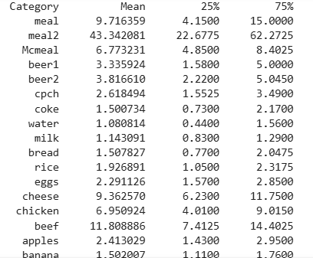
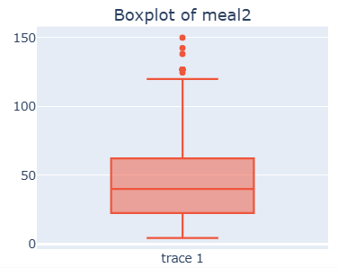
Data Exploration

Slide 6
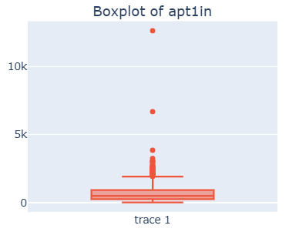
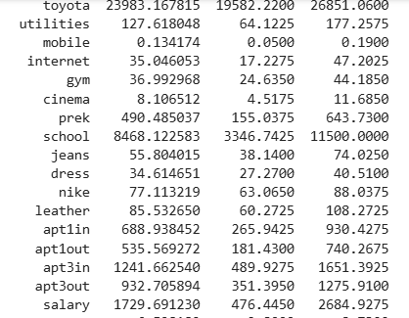
Data Exploration

Slide 7
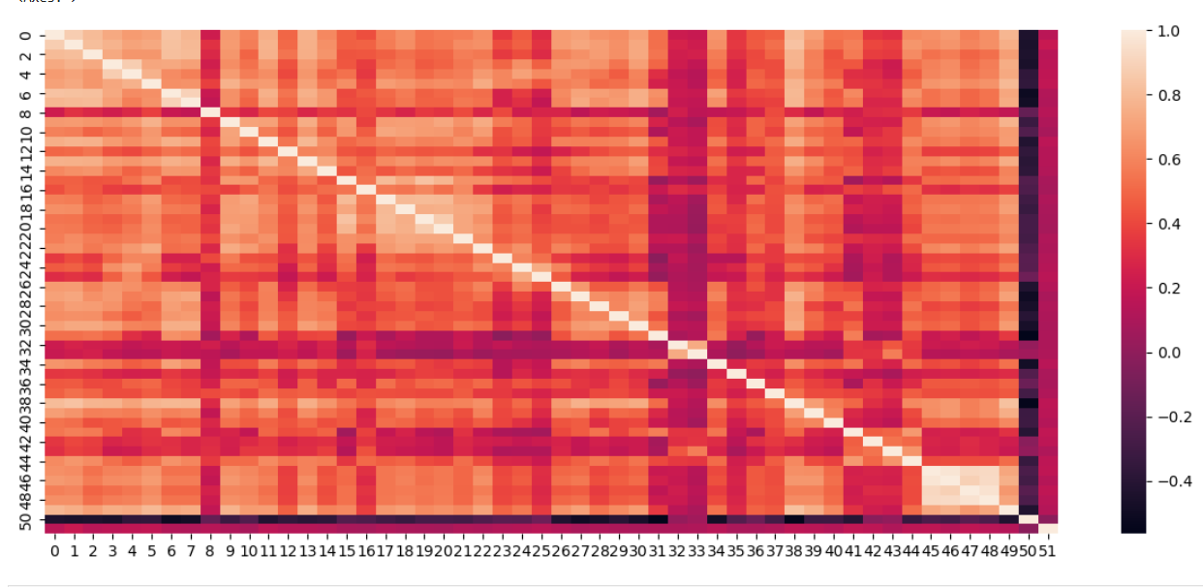
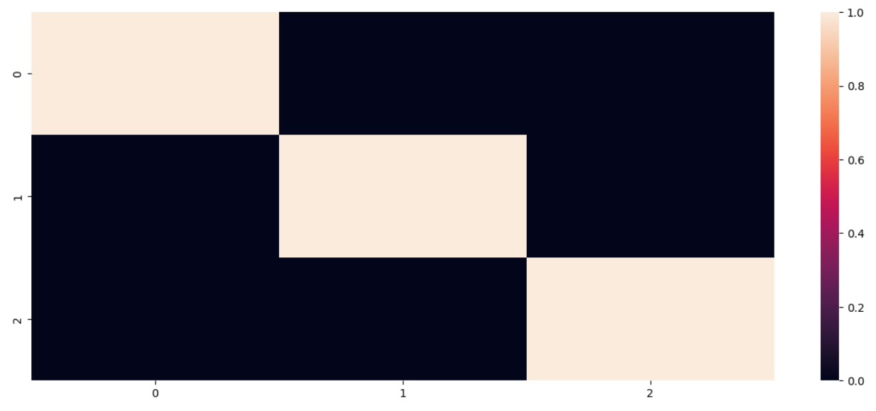
PCA Dimensionality Reduction
PCA Dimensionality reduction resulted in summarizing data so new features aren’t related to each other.

Slide 8
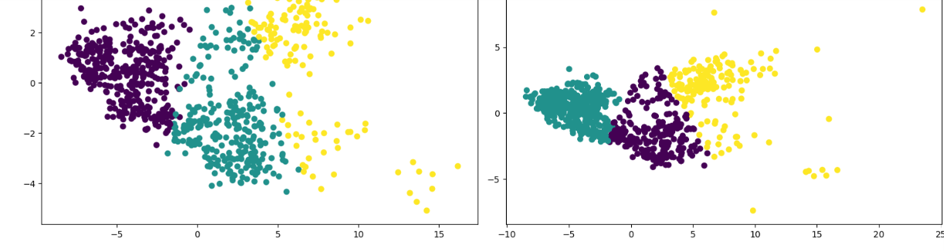
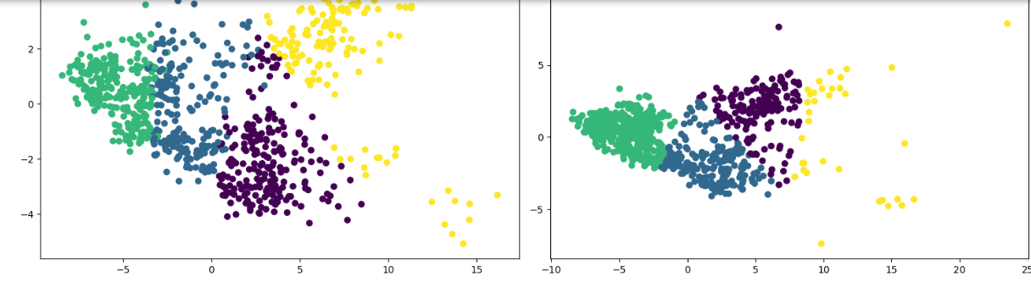
PCA CLUSTERS. Examples with 3 and 4 clusters.

Slide 9
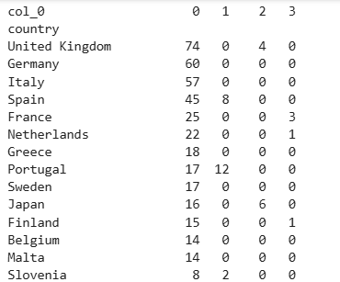
Clusters/Countries Contingency Table
Cities within the country can belong to different clusters
1st cluster: UK, Germany, Italy, Spain, France, Netherlands, Greece, Portugal, Sweden, Japan, etc
2nd cluster: India, Brazil, Mexico, Russia, China, Turkey, Romania, Ukraine, Poland, Hungary, etc
3rd cluster: United States, Canada, Australia, Japan, New Zealand, South Korea, UK, etc
4th cluster: Israel, Switzerland, Norway, Denmark, Iceland, France, Barbados, etc

Slide 10
Clustering Evaluation
PCA with 4 clusters: ARI - 0.1, silhouette score - 0.245 - best algorithm
PCA with 5 clusters: ARI - 0.1, silhouette score - 0.147
Agglomerative clustering with 4 clusters, cosine: ARI - 0.11, silhouette score - 0.11
Agglomerative clustering with 4 clusters, ward: ARI - 0.11, silhouette score - 0.24
ARI score goes up with the increase of number of clusters.
We don’t have predetermined categories to compare clusters to, and the goal is to summarize 144 countries into fewer groups, so silhouette score should be used in identifying the best clustering algorithm.

Slide 11
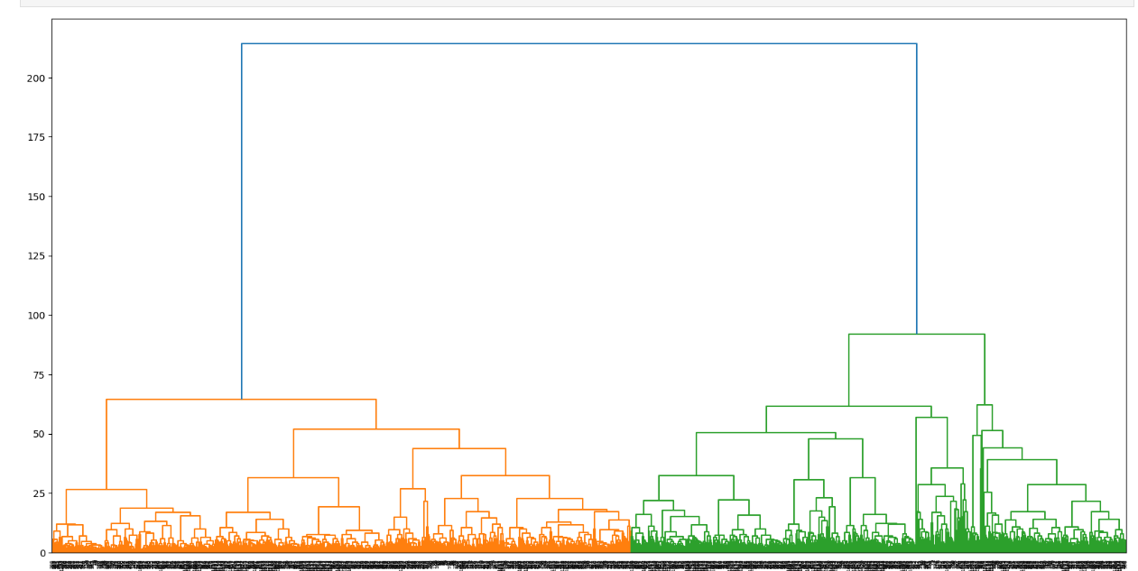
Dendrogram with method “Ward”

Slide 12
Takeaways and Further Considerations
Best clustering algorithm created for global cost of living dataset is PCA. It’s segments all cities into 4 groups with a silhouette score of 0.245
For an in-depth analysis we can look into monthly purchases of goods and services/vs one-time cost which would give features equal weight in the dataset.
Also a separate analysis can be created for different groups of consumers: renters/owners, people with kids/without, living in the city/outside of the city, etc.

